Slide 1
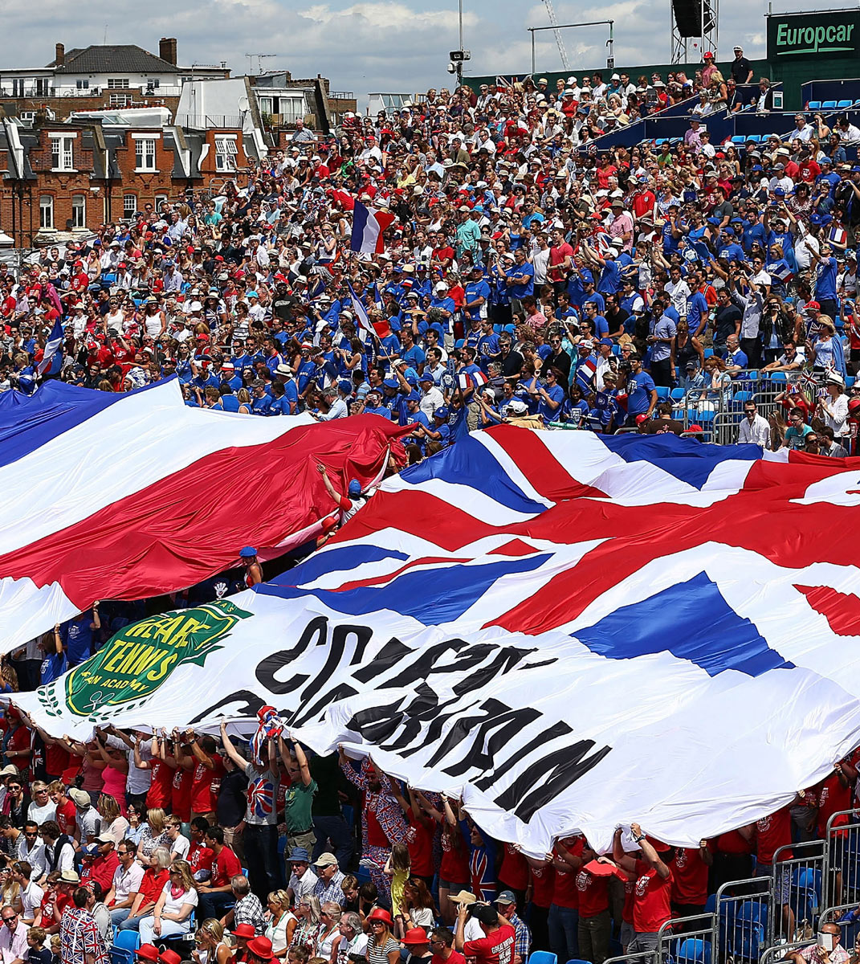

CMS & TTP guide – LTA Youth Matchplay Competitions
The timings below are designed to be used alongside the CMS & TTP video for G6 events
Click here to access the video
Time | Subject
 | Competition Management System (CMS)
00:00 – 01:39 | Accessing the Competition Management System (CMS)
01:39 – 04:32 | Uploading the details of you competition
04:32 – 04:52 | Getting you event approved
04:52 – 05:21 | Locating your submitted event in CMS & getting it approved
05:22 – 08:39 | Editing your fact sheet
08:39 – 11:07 | Publishing – Viewing online – Entries – Stripe – Settings Tab
11:07 – 11:54 | Public view of your event
 | Tennis Tournament Planner (TTP)
12:08 – 13:29 | Linking your competition to TTP
13:29 – 14:11 | Downloading a sanctioned tournament
14:11 – 17:00 | Properties tab
17:00 – 19-32 | Downloading players/entries into your TTP file
19-32 – 21:15 | Player Validation
21:15 – 23:25 | Adding and developing your Roster
23:25 – 28:00 | Making the Draw
28:00 – 28:30 | Printing your draws
28:43 – 32:24 | Adding in your scores
32:24 - 35:24 | Publishing & Submitting your results

