Slide 1
Unitc1
Developing
coaching skills

Slide 2
Unit aims
You will will develop your coaching knowledge and skills to help improve others’ performance skills, techniques and tactics across a range of sports.
Learning aims
In this unit you will:
Explore the responsibilities of an assistant coach
Prepare sport and activity sessions
Explore and develop assistant coaching skills
Review sport and activity sessions as an assistant coach

Slide 3
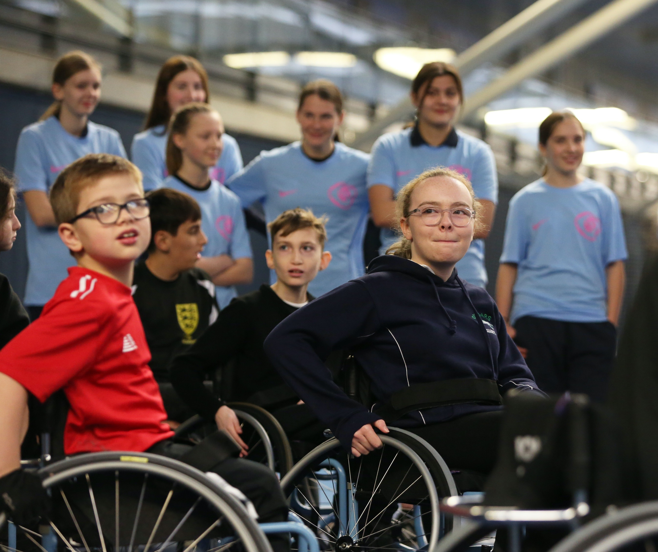
A1: assistant coaching roles
?
The role of the lta
What is the organisational structure
of the LTA?
What are the LTA’s aims and objectives?
What is the LTA’s vision,
mission and goals?
What products does the LTA offer?
What are the impacts of the LTA on participants and communities?

Slide 4
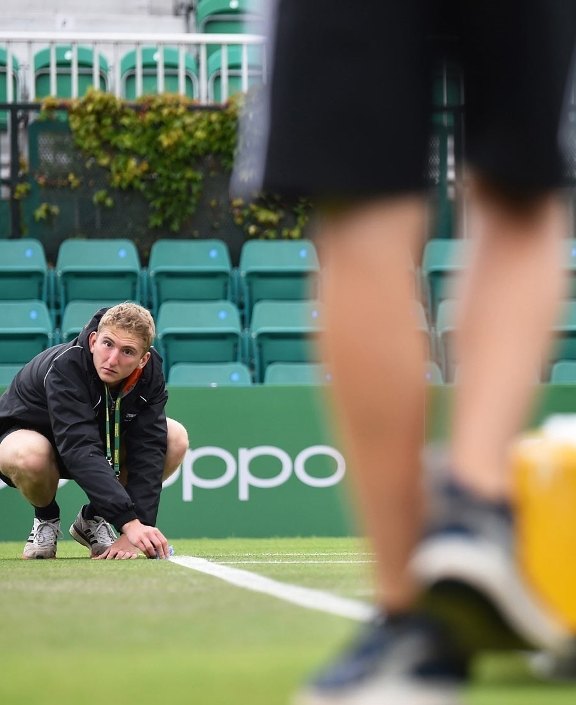
A2: assistant coaching roles
The role of an assistant tennis coach
Can you provide tennis examples to explain the following roles:
Personal responsibilities and contribution
Part of a wider coaching team
Codes of conduct
Personal goals and motivation
Supervision
Lines of reporting and recording information
What impact can an assistant coach have on the participants experience? | ?

Slide 5
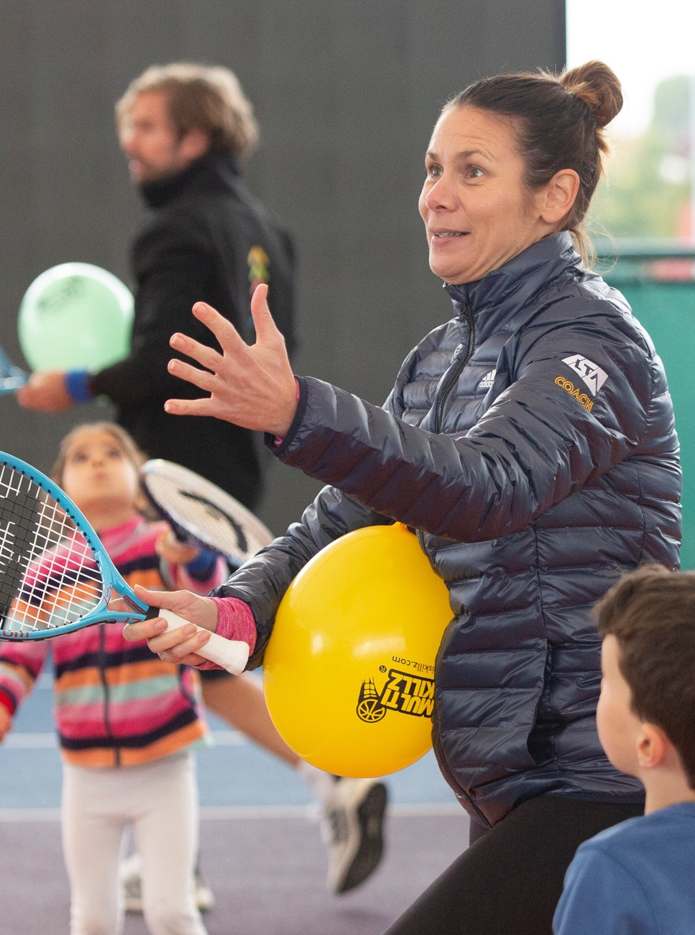
A1: assistant coaching responsibilities
As part of a coaching team an assistant coach has responsibilities which impact on participants and the community.
Customer service standards:
Professional presentation
Being approachable
Participant engagement
Participant retention
Knowledge of participants:
Motivation
Personal background
Health background (medical, physical and mental)
Participant expectations

Slide 6
lta assistant coaches
The role of an LTA Assistant Coach is to vital to coaches and programmes to help them attract and retain more people in the game.
The LTA Assistant course provides the skills and knowledge required to be a valuable member of a coaching team.
Role: an LTA Assistant is given a position,
e.g. assistant within a group coaching session.
They will always be under the supervision of
a more experienced and higher qualified,
LTA accredited coach.
Responsibilities: specific tasks or duties
carried out as part of the role.
Assistants are crucial in growing British Tennis to inspire and motivate the people they work with. Players will want to come back week after week because of the impact made by the coaching team of which assistants are an integral part.
The LTA’s vision is:
tennis
opened
up

Slide 7
lta assistant:
roles & responsibilities
There are two main roles of an LTA Assistant Coach:
1
2
Assisting a lead coach in a group coaching or activity session
Responsibilities within this role may include:
Setting up and packing away equipment
Taking a register
Providing demonstrations for players
to learn from
Leading small groups of players
within a larger group
Supporting the running of competitions
Responsibilities within this role may include:
Scoring matches
Managing the draw
Presenting prizes

Slide 8
lta assistant:
roles & responsibilities
As an Assistant Coach there are responsibilities across all of the roles:
Professionalism
Communication
Organisation
Safeguarding and Inclusion
i | Find out more about the roles and responsibilities of an LTA Assistant: LTA Assistant Overview www.lta.org.uk/roles-and-venues/coaches/qualifications
Notes:
LTA Assistant Overview – online learning https://rise.articulate.com/share/pZGZ67Ixku5u5pmcMk3IcG7WbS2i9yqF

Slide 9
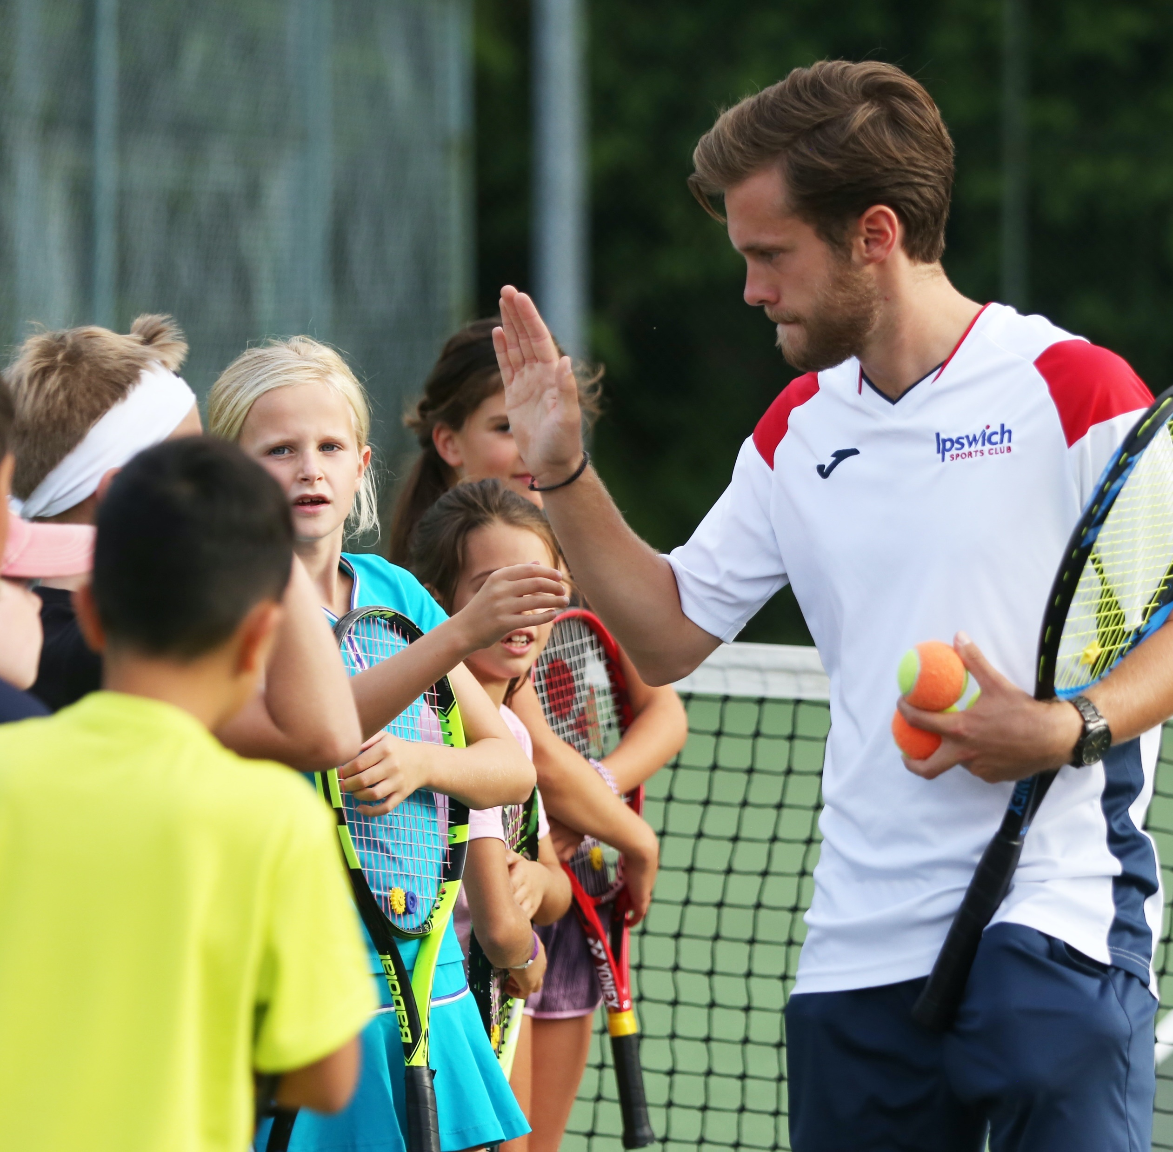
a2: ASSISTANT COACHING RESPONSIBILITIES
How do the responsibilities of an
LTA coach impact participants and
the community?
Community links
Increased participation
Positive image of tennis and the LTA

Slide 10
a2: ASSISTANT COACHING RESPONSIBILITIES
Professional conduct
As an assistant coach you have a duty of care
to all participants, you must follow equality and diversity and behave honestly and with integrity
An assistant coach is a powerful role model
to children and adults and should be positive
and empowering
You must demonstrate respect for all
participants and this will allow you to maintain
a participant focus
You must work within the scope of practice
and responsibilities allowing participants to develop skills and techniques
It is important that an assistant coach works
in line with organisational policies and
procedures and continuing professional development (CPD)

Slide 11
a3: Legislation
and guidelines
Legislation and guidelines are there to keep everyone safe and to ensure that everyone is treated fairly.
They aim to reduce the likelihood of accidents and injuries and give clear guidance about procedures to be followed if an incident or accident occurs.
Legislation must be followed and non-compliance can result in criminal prosecution.
Some of the most relevant legislation
for an assistant tennis coach include:
Sport England guidelines (including child protection in sport unit)
Disclosure and Barring Service (DBS) checks
Data protection legislation
Equality legislation
Legislation regarding children and families
First aid regulations
Guidelines of national governing bodies (NGBs) or employer

Slide 12
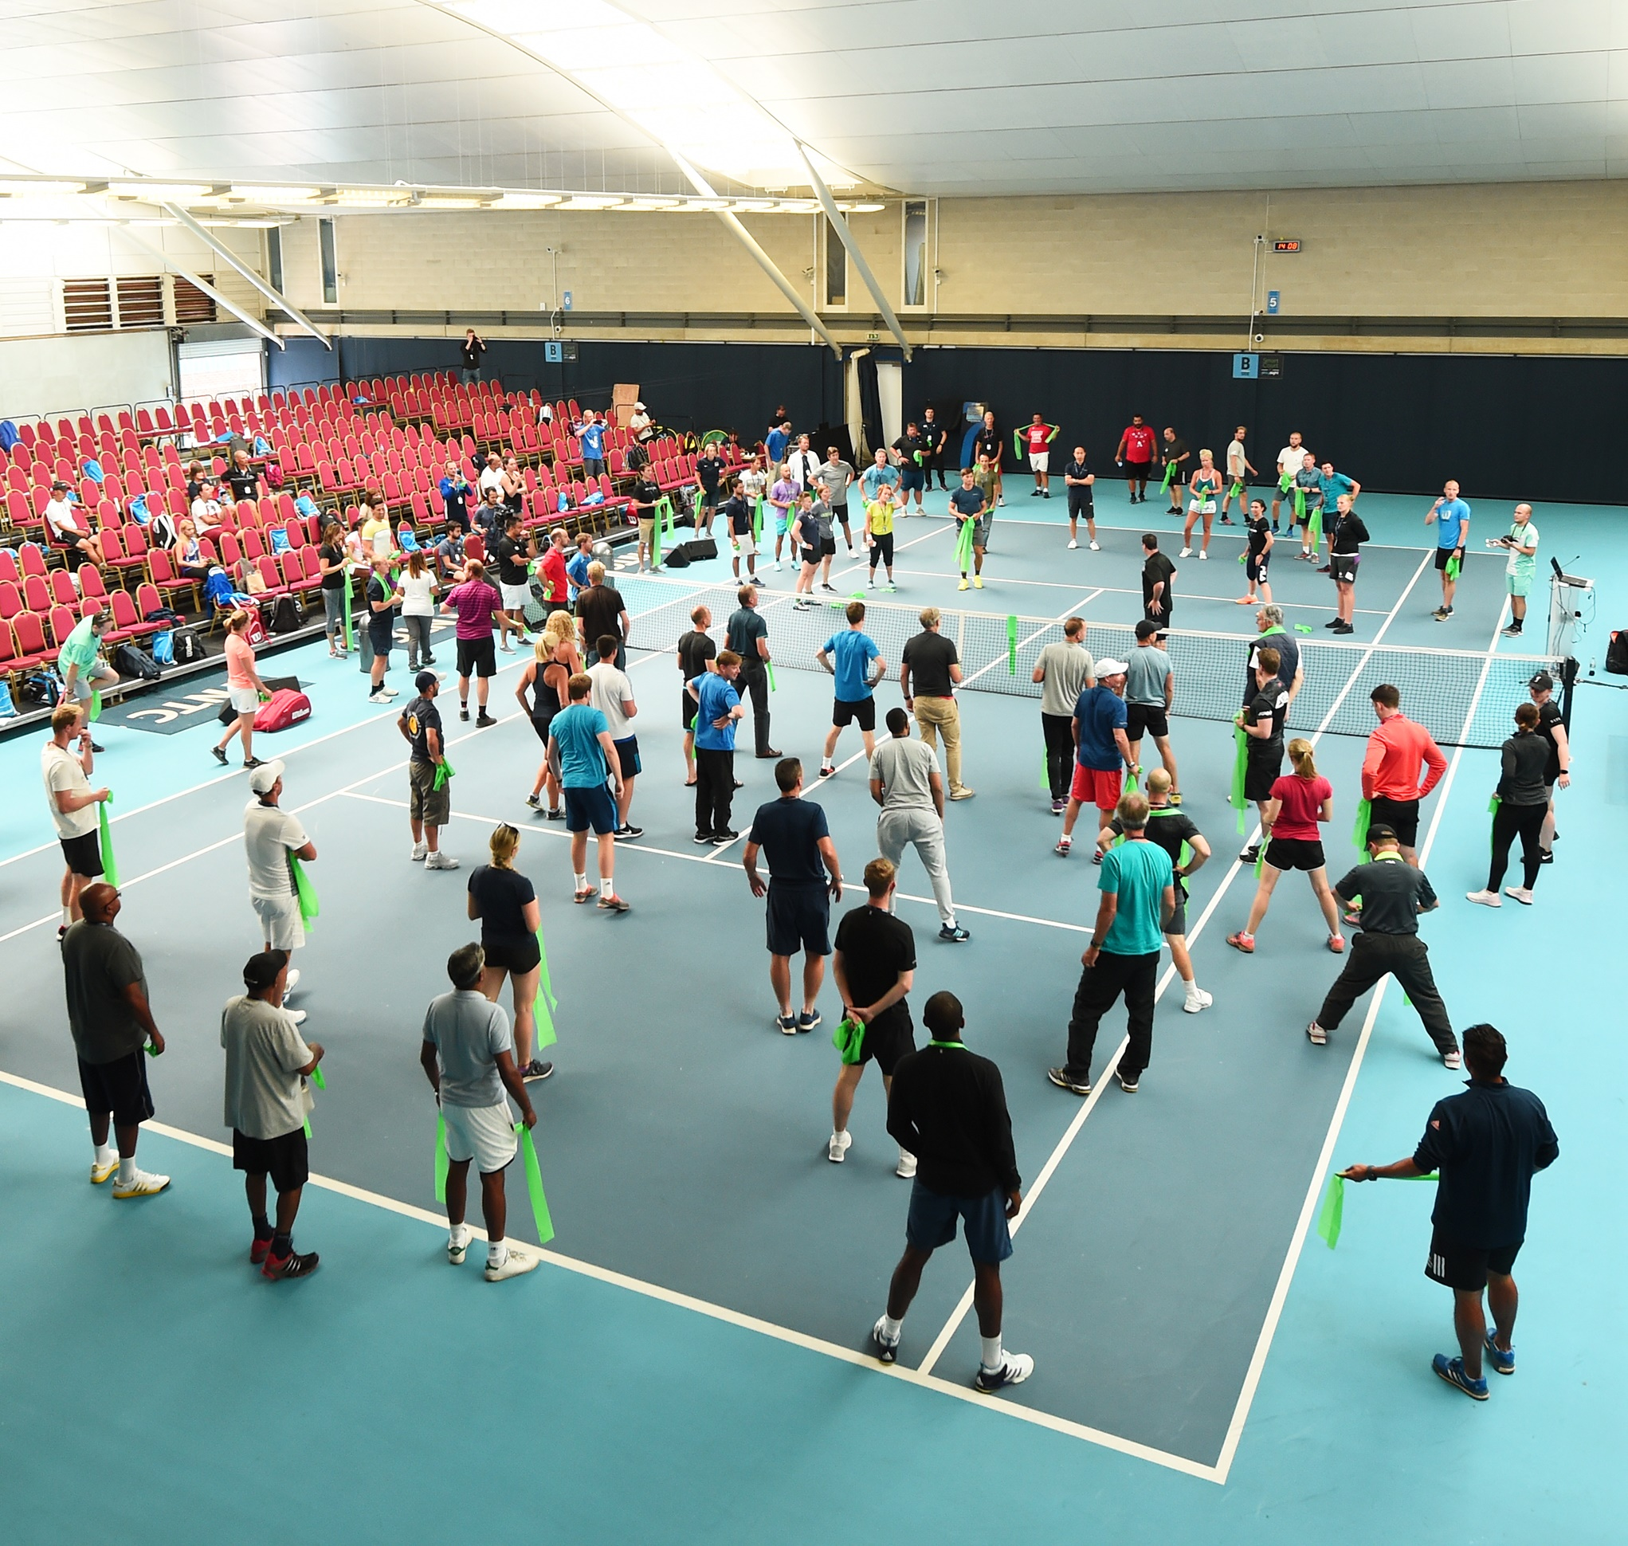
A4: policies
and procedures
Risk assessment and risk management
Admissions policy
Equality and diversity
Dismantling, storage and ensuring the safety of equipment (servicing and maintenance)
Manual handling
Personal protective equipment (PPE)
Normal operating plan (NOP)
Emergency action plan (EAP)

Slide 13
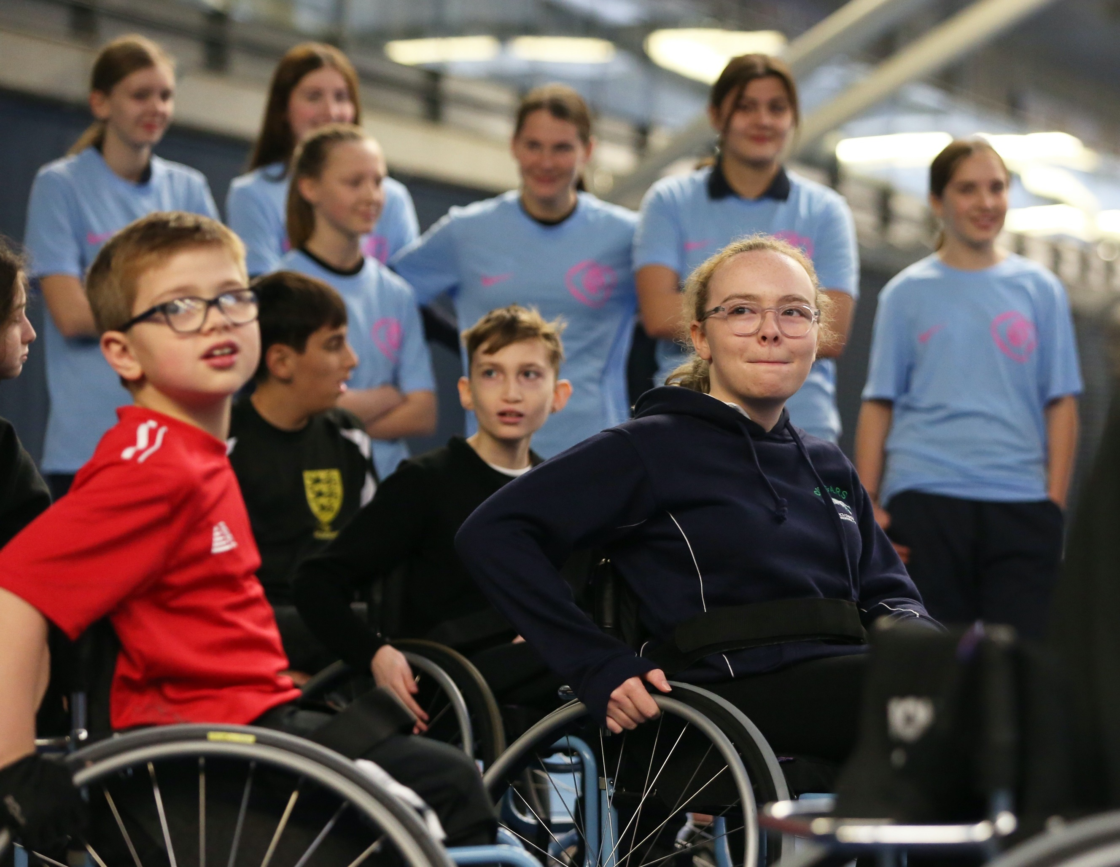
?
A4: policies
and procedures
Risk Assessments and
Emergency Actions Plans
What is the purpose of risk assessments and emergency action plans?
What information do you need?
What should an assistant coach do
with a risk assessment and emergency action plan?
What are the organisational
requirements for risk assessments
and emergency action plans?
Who produces risk assessments and emergency plans and how often?

Slide 14
b1: theories of
coaching and learning
What is the participant journey?
An experienced coach will be aware of the environment where the session is taking place.
They will take account of any risks in order to make it safe for participants, any weather issues and the availability of equipment.
To ensure a positive participant journey a sessions must be:
Well planned
Have clear aims
Encourage player feedback
Encourage learners to develop and succeed

Slide 15
b1: theories of coaching and learning
Leadership styles
Autocratic
The leader makes decisions without taking input from anyone Participants are expected to adhere to the decision
Democratic
The leader makes decisions Each participant has an equal say
Laissez-faire
The least intrusive form of leadership The French term for "let them do” Nearly all authority is given to the participants

Slide 16
b1: theories of
coaching and learning
?
Coaching and Learning Theories
Classical conditioning
Operant conditioning
Observational learning
Thorndike’s law
What are the main ideas of each theory?
How can each theory help us understand how participants learn tennis?
How can each theory help you to be a
better tennis coach?

Slide 17
?
b1: theories of
coaching and learning
Methods to assess progress
Coach assessment
Self-assessment
Peer assessment
Observation
Performance profiling
Statistical performance analysis
WHICH METHOD IS:
The most reliable?
Quickest to use?
Best to use outside / inside?
Most suitable to use with a large group or individuals?

Slide 18
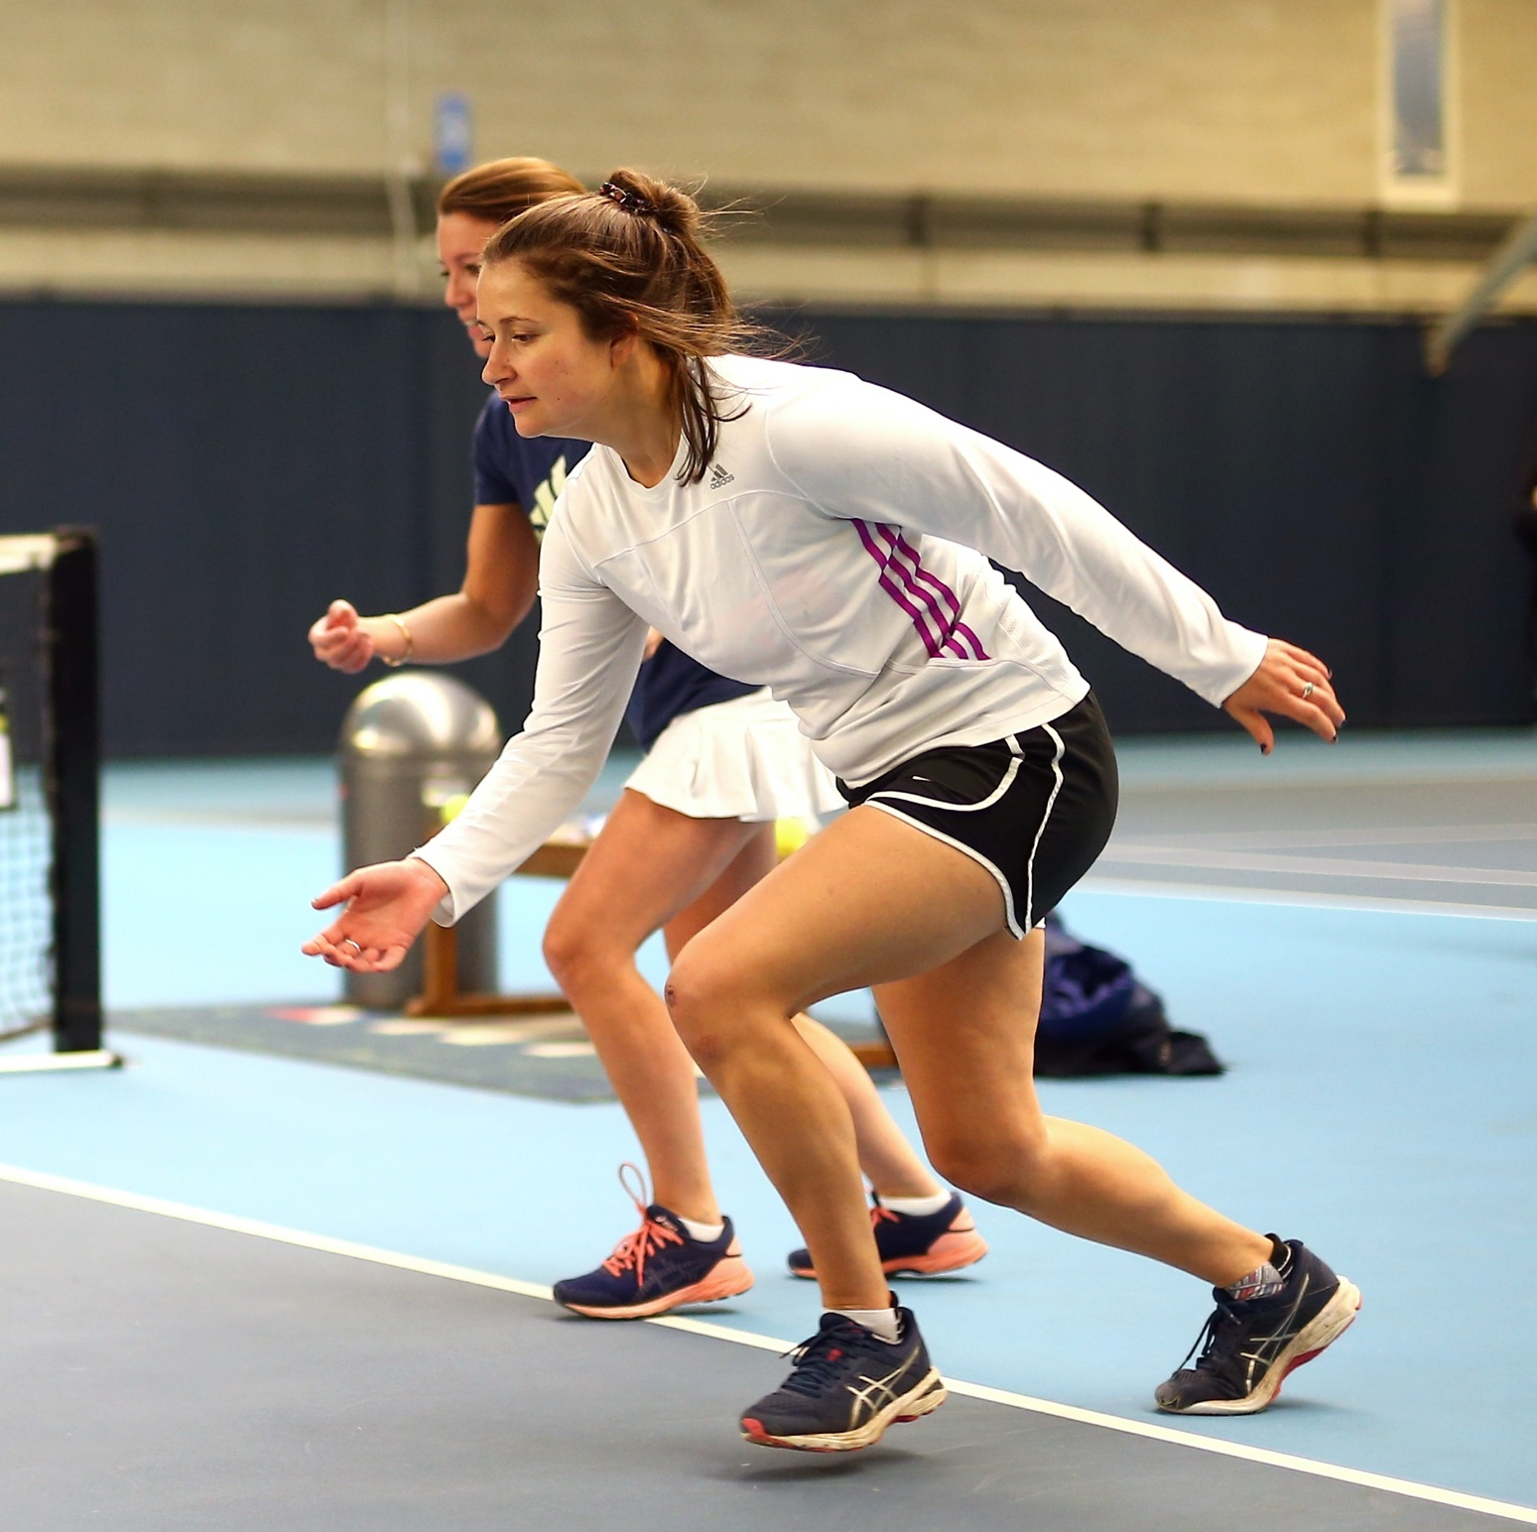
b1: theories of
coaching and learning
Classification of practice to improve skills and techniques
Skills can be classified in different ways.
The main classifications are:
Open / closed
Gross / fine
Simple / complex
Discrete / serial / continuous
Can you identify the classification for each of the following tennis skills: • Serve • Return of serve • Lob • Smash | ?

Slide 19
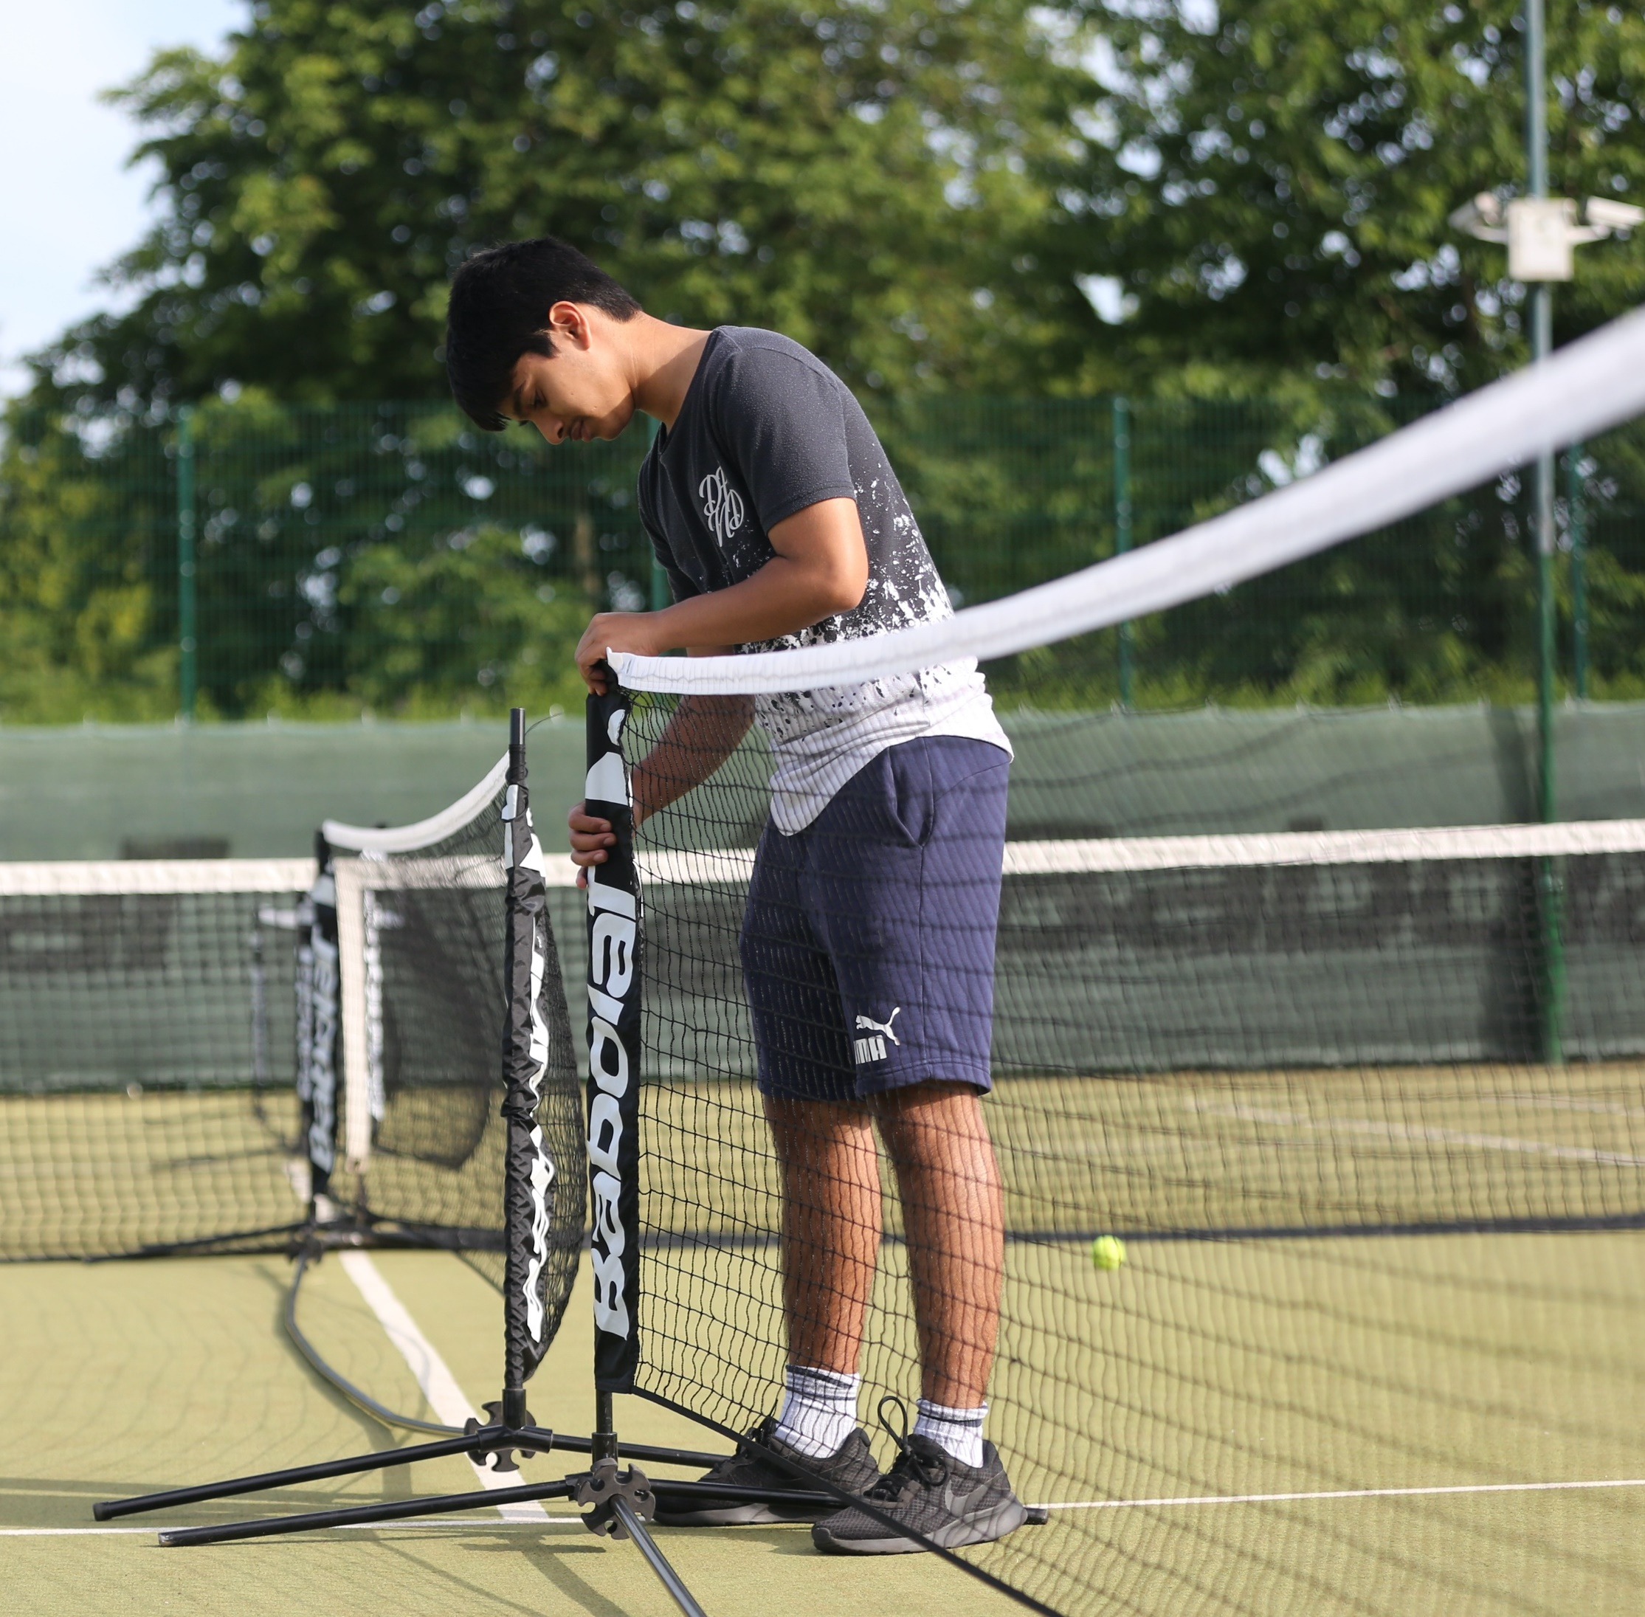
B2: planning
for participation
What information do you need to plan and prepare for a coaching session?
Age
Gender
Level of ability
Previous experience
Level of fitness
Medical history
Welfare needs and any disability
Why is it important to know about individual and group needs? Think about coaching a tennis session. How would you use this information to plan your session? | ?

Slide 20
b2: planning for PARTICIPATION
Activities related
to participant /
group needs
Differentiation
to stretch
and challenge
A good session plan will be
well planned and contain all
the information the coach
needs to successfully deliver
the session, meeting the
needs of the individuals
and the group.
Progressive SMART targets, linked to the overall aims
and objectives
Resources, equipment requirements
Session plan content
Contingency planning based on risk assessments
Coaching
methods to
develop participant performance
Aims and objectives

Slide 21
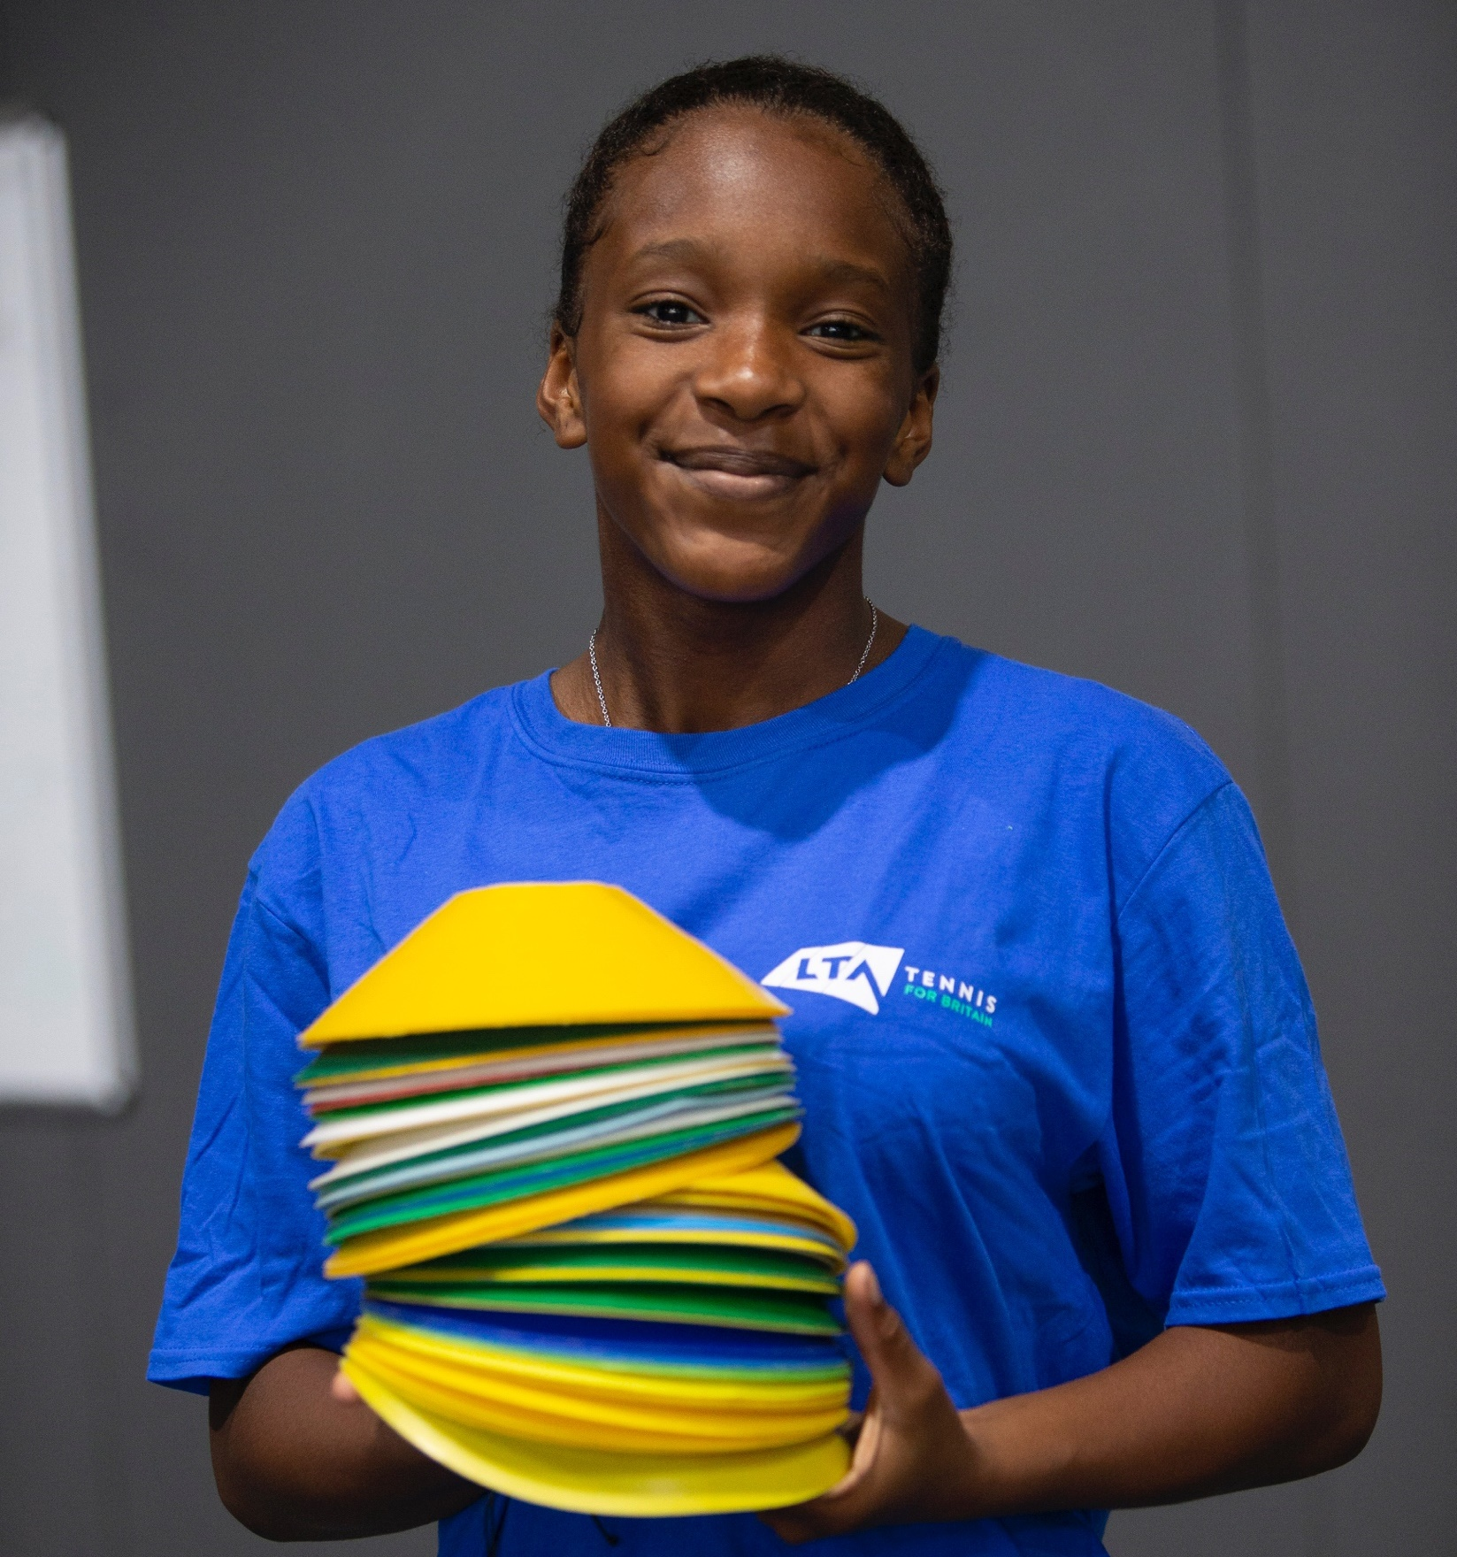
b3: preparing the environment
and participants
Before all sessions the coach will prepare
the environment and equipment to:
maintain health and safety
fulfil all legal obligations: child protection, safeguarding, and insurance
select an appropriate space
clearly identify the space to be used
check the space is clean, tidy, fire exits are clear
identify the types of equipment that will be used
check the environment is safe
At the end of the session they will:
dismantle, store and maintain equipment

Slide 22
b3: preparing the environment
and participants
?
Preparing participants
It is important to prepare the equipment and environment for a coaching session, but equally important to prepare the participants. The following procedure can be used at the start of a session:
Welcome
Explain rules and expectations about punctuality and attendance
Deliver the session aims / goals
Check participant readiness, they need to know
what to expect in the session
Ensure participants have the correct clothing and footwear
Establish rules
Ensure welfare needs are met
Why do you think it is important
to prepare the participants?
What could be negative and
positive impacts of following the listed procedures, for the coach,
the participants and the LTA?

Slide 23
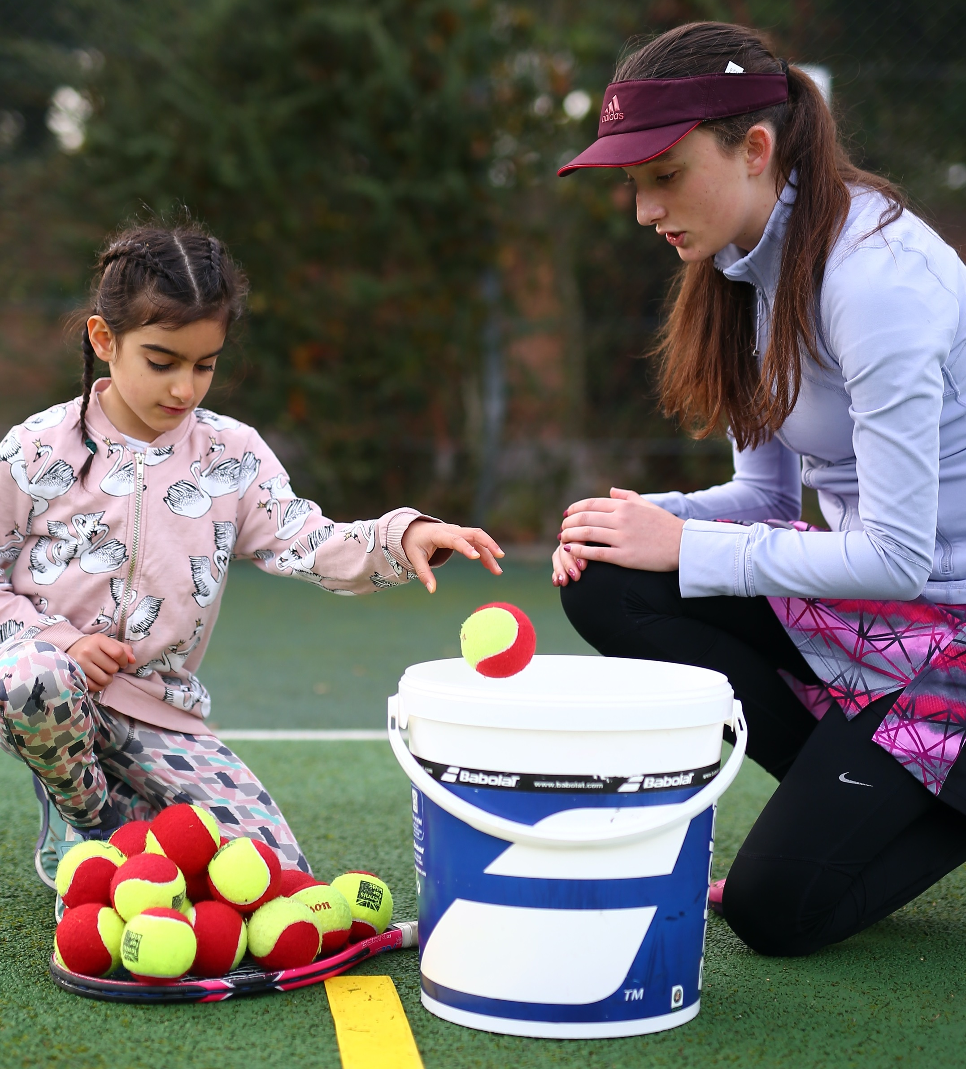
b3: preparing the environment
and participants
The environment must be in line with the organisational and legislative policies and procedures.
Normal operating plans (NOP)
Emergency action plans (EAPs)
Risk assessments
Safeguarding policies and procedures
What is the importance of these policies and procedures for the participants, tennis coaches and the LTA? | ?

Slide 24


c1: ASSISTANT coaching sKILLS
Communication skills:
Observation / non-verbal techniques
/ body language
Open / closed questioning
Active listening
Adapt to meet participant needs
Find out how tennis coaches use different forms of communication by watching this short video.
? | Can you identify examples of how a tennis coach uses each of the different types of communication? For example, the tennis coach uses non-verbal communication by nodding when a good serve is hit.

Slide 25
Teamwork
Analysis and interpretation of information
Time management
Planning and preparation
of activity sessions
Ensure participant enjoyment and retention
c1: ASSISTANT COACHING SKILLS
Give effective feedback using the feedback cycle
Manage participant behaviour and conflict
Rapport building
Obtain feedback from participants
Organisation

Slide 26
C2: delivering sport
and activity sessions
Revise your session plan if appropriate,
to meet the needs of the group, individuals, environment, etc
Prepare equipment, the facility and participants
Warm-up, such as pulse raiser, mobility, dynamic movement, stretching and skill rehearsal
Main content, skills and technical development
Effective demonstration, by the coach
and participants
Revisiting goals with participants to
check progress
Ensure inclusivity and adapt the session
to meet individual participant needs
Observe and analyse participants’ performance
Cool down
Give advice on future sessions
Dismantle and remove equipment

Slide 27
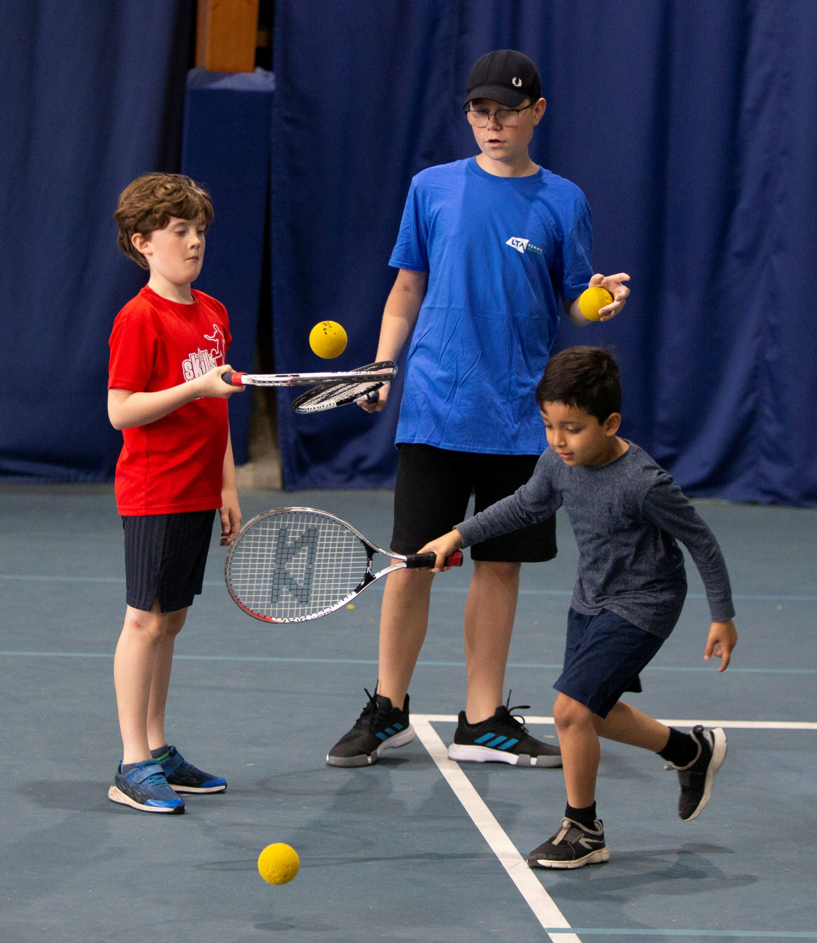
C2: delivering sport
and activity sessions
The role of an Assistant Coach:
Demonstrate professional behaviour, e.g. dress, punctuality
Use customer service skills such as problem solving, discretion, imitative, influencing, teamwork, suitable language
Apply appropriate coaching styles and methods
Apply learning theories to support personalised learning
Manage pace
Manage hazards and risks
Use appropriate communication skills
Comply with all legal and organisational responsibilities
Provide formative feedback to participants

Slide 28
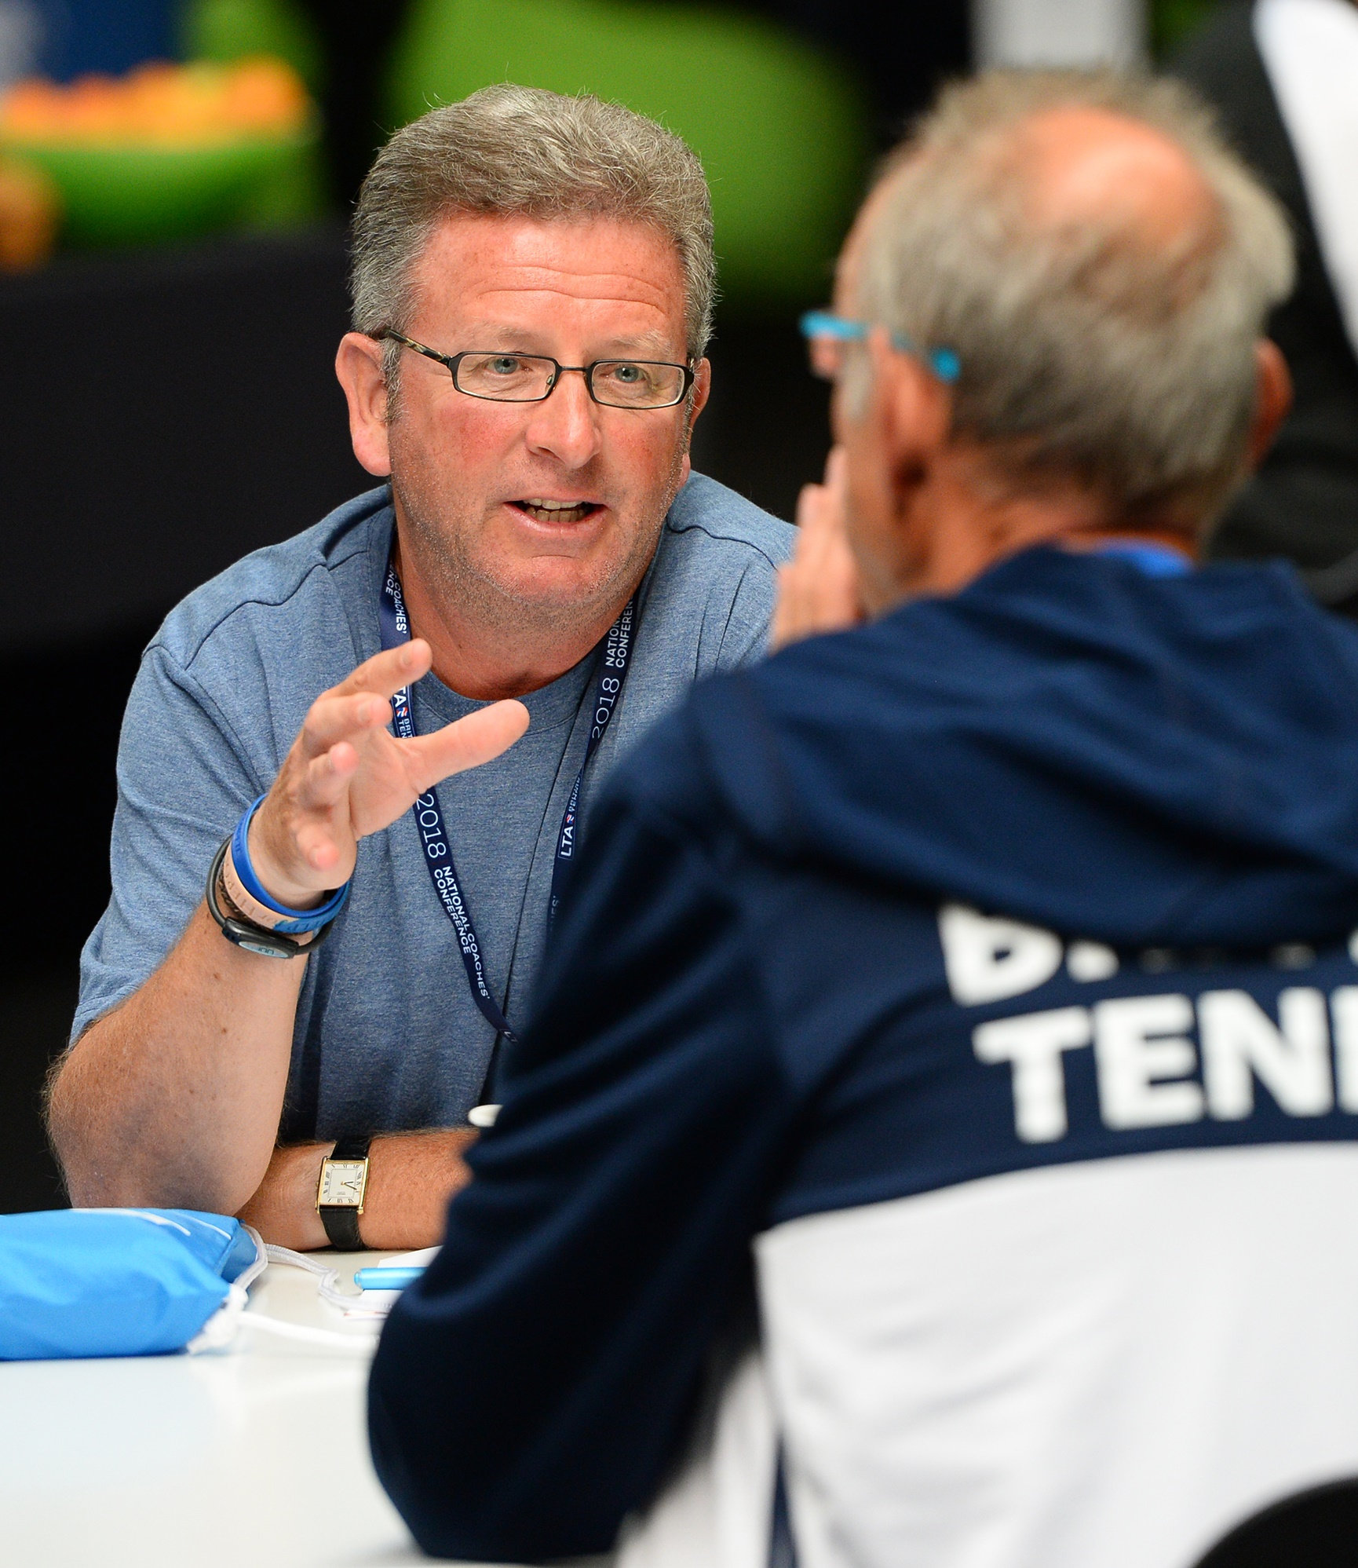
d1: personal development
through review
?
Sources of feedback:
Participant, coach, peers, colleagues, self-review
Questionnaires
Comment cards
One to one
Which types of feedback have you used?
Which type of feedback have you found the most beneficial?
Can you think of situations where certain sources
of feedback are more or less appropriate?

Slide 29
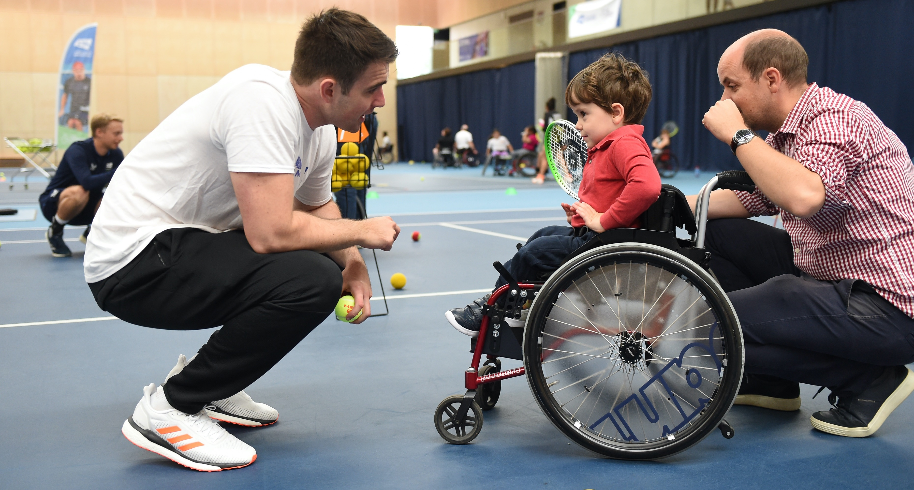
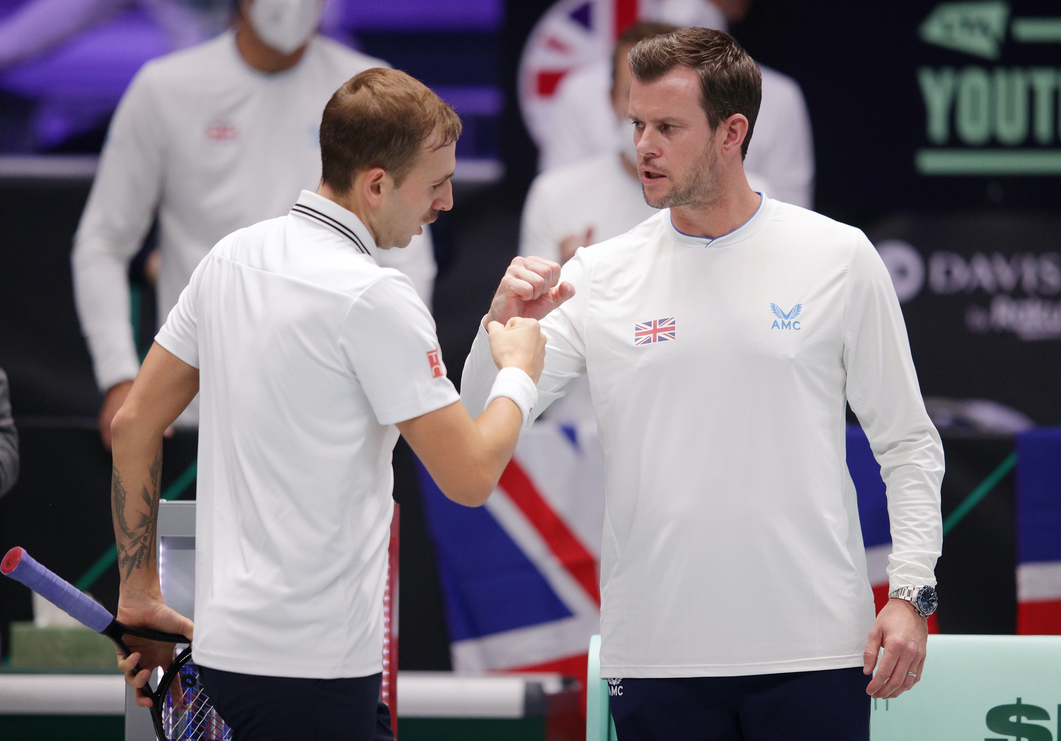
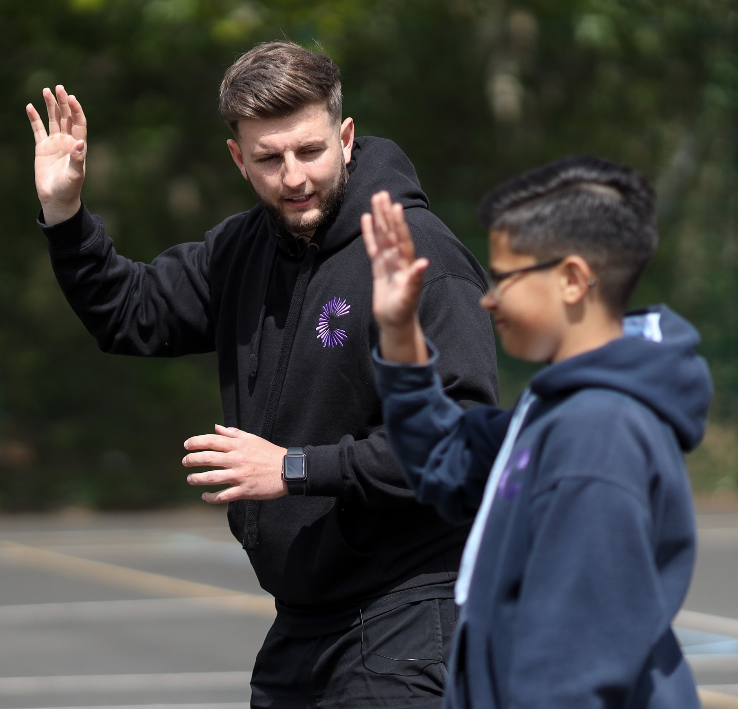
d1: personal development
through review
Reviewing a session:
Reviewing your own performance is highly beneficial. It allows you to consider all aspects of your coaching ability and to set yourself goals for future development.
Look at the coaching styles of different
tennis coaches and compare their styles
with yours.
Compare the coaching styles of
coaches in other sports.

Slide 30

d1: personal development
through review
Professional development:
Development plan
Activities available for development
Various levels of LTA courses
Mentor development
Self-reflection

