Slide 1
EMPLOYABILITY:
ADVANTAGE

Slide 2
TEACHER NOTES
    RESOURCE OVERVIEW
        Whilst these lessons are created by the LTA, no prior experience or knowledge of tennis is required by either the teacher or students. The focus of this unit is on transferrable employability skills, using examples from professionals who work in tennis and young people who play tennis to help bring some of these key themes and concepts to life. The employability skills covered can be applied to exam skills, revision, application forms and interviews for colleges or part-time jobs.
        Teachers notes can be found underneath the slides.
    AGE: 14-16
    TIME: 20-30 MINUTES
    LEARNING OBJECTIVES
        To understand key employability skills
        To analyse how employability skills can be developed
    PREPARATION
        Read through the slides to familiarise yourself with the content of the lesson and check technology supports any media content.
        Consider any students who may need extra support beyond that already offered in the activities so that the learning can be differentiated for all students.
        Also consider any links can be made with employability/careers programmes already in place within your school.
    CROSS CURRICULAR LINKS
        Consider and encourage students to make any cross curricular links such as Business, English , Physical Education or wider school careers programmes.
        Curriculum Links for England, Wales and Scotland are below in the teacher notes.
        For further advice around employability and teaching careers:
        DFE Careers guidance for Schools -
        https://assets.publishing.service.gov.uk/government/uploads/system/uploads/attachment_data/file/748474/181008_schools_statutory_guidance_final.pdf
        The Gatsby Benchmarks -
        https://www.careersandenterprise.co.uk/schools-colleges/gatsby-benchmarks
        Skills Builder - One universal framework for essential skills -
        https://www.skillsbuilder.org/
Notes:
(Teacher Only)
Curriculum Links:
England – PSHE Association Programme of study (KS4)
Students will learn:
L2. to evaluate their own personal strengths and areas for development and use this to inform goal setting
L3. how their strengths, interests, skills and qualities are changing and how these relate to future career choices and employability
L4. about the range of opportunities available to them for career progression, including in education, training and employment
L5. about the need to challenge stereotypes about particular career pathways, maintain high aspirations for their future and embrace new opportunities
Scotland - Career Education Standard
By the end of BGE:
• I can demonstrate and apply the skills I have learnt across the curriculum in relation to the world of work.
• I can identify my interests, strengths and skills and use them to make informed choices.
• I can understand and consistently demonstrate the behaviours an employer looks for in a good employee.
Wales - Careers and the world of work: Framework (KS4)
Learners should be given opportunities to:
7. consider their own and other people’s perspectives about learning, careers and the world of work to inform opinions and decisions
10. examine their careers ideas and the potential effects on their lives
14. be able to apply learning to a range of situations both within and outside school

Slide 3
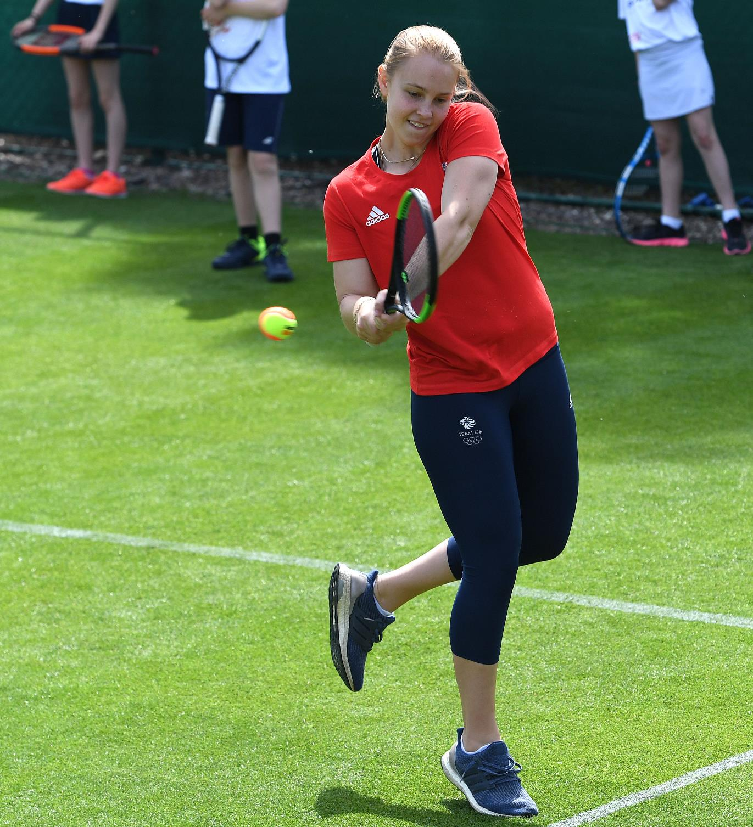
ADVANTAGE:
EMPLOYABILITY SKILLS
“
  IN THE WORKPLACE, SKILLS
  ARE MORE IMPORTANT THAN
  ACADEMIC ACHIEVEMENT
  Are you for or against this statement?
  Write down as many reasons as you
  can to support your argument.
”
  Challenge:
  What does ‘transferrable skills’ mean and can you think of some examples?
  Advantage in tennis means you have the slight lead over your opponent and are close to winning a game. In what ways might this title relate to employability skills?
Notes:
Starter: Mini debate (4 mins)
Show students the quote above and ask them to either write down their responses or debate in pairs/small groups.
Support: Give students some sentence stems – Skills are more important than grades because…/Grades are more important than skills because…
Explain to students that a combination of both can be important, but skills are often focussed on less in schools whilst often given a lot of focus by employers – however, this will obviously depend on the job in question.
Ask for feedback on the challenge question. Explain to students what ‘transferable skills’ means and that in this lesson they will be learning about key skills for the workplace, but that these skills are also relevant to other parts of live such as home, school, extra-curricular activities and social life.
Transferable skills: skills that can be useful and helpful in different areas of life e.g. home, school, work.

Slide 4
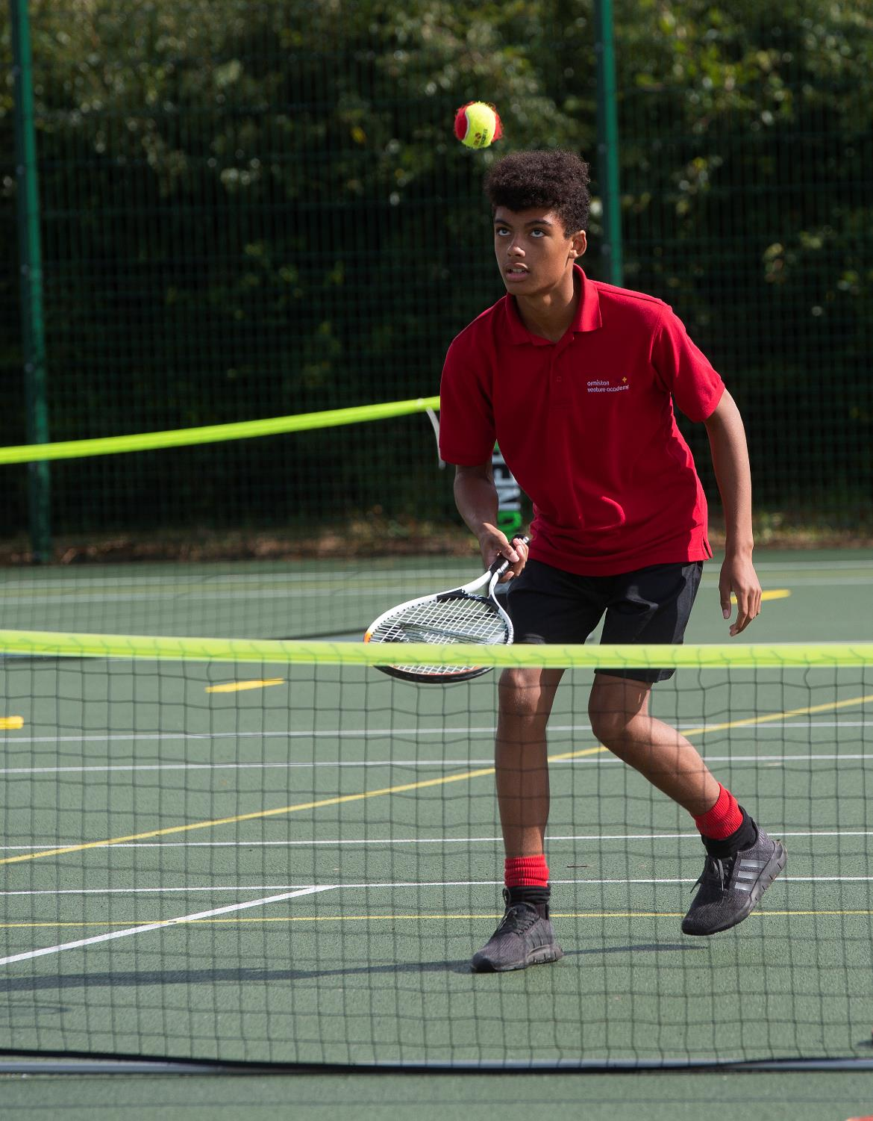
SESSION
OBJECTIVES
To understand key employability skills
To analyse how employability skills can be developed
Notes:
Session objectives (1 min)
Read through the session objectives as a class.

Slide 5
SKILLS, SKILLS, SKILLS
  Communication
  Self-management
  Team-player
  Perseverance
  Resilience
  Respect
      A. Working effectively with others for the best outcomes
      Challenge
      Pick a few of these skills and think of one example of how they could be a beneficial skill in school (e.g. preparing for exams) and one example
      of how it could be beneficial
      in a job/ apprenticeship.
      B. Being able to keep going even when things are difficult
      C. Treating others well and not judging them. Appreciating and encouraging them
  D. Being able to share ideas and feelings clearly and in a variety ways
      E. Being able to set individual goals and take responsibility for personal actions
      F. Bouncing back from failure or setbacks
Notes:
Skills, skills, skills a. (4 mins)
Show students the of transferrable skills above and ask them to match up the skills with their correct definitions. Remind students that these key employability skills are also important skills in school.
Support: This could be printed out for SEND students and they can match them up and come up with an example of each
Challenge: Pick a few of these skills and think of one example for how it could be a beneficial skill in school (e.g. preparing for exams) and one example for how it could be beneficial in a job or work experience.
Go through the answers as a class:
D
E
A
B
F
C

Slide 6

JOB
PROFILES
Looking at the profiles, which skills might be needed for each job role and why?
    TENNIS COACH
      Giving advice to tennis players.
      Understanding tennis techniques.
      Motivating players and encouraging them to progress.
      Implementing training routines.
    NUTRITIONIST
      Keeping up to date with the latest information and research.
      Giving advice on how to eat better.
      Motivating people and creating nutrition plans.
    FINANCE BUSINESS PARTNER
      Organising budgets and processing invoices.
      Keeping track of spends and costs associated with contractors.
      Planning ahead and projecting income.
Notes:
Skills, skills, skills b. (4 mins)
Ask students to discuss in pairs which skills do you they think would be required for each job based on the information? Explain that thinking about transferrable skills can be really useful when applying their first job, work experience, apprenticeship or a place at college – by looking at what the role is and considering what skills are needed.
Support: This slide could be printed out and students first highlight any key words in the role and then have to pick one skill that is needed for each role.
Challenge: What do you think are the main opportunities and challenges of each of these job roles?

Slide 7
LISTEN TO THE PROFESSIONALS IN THIS VIDEO -
WHICH SKILLS ARE NEEDED FOR
EACH JOB ROLE
AND WHY?
Notes:
Skills, skills, skills c. (4 mins)
As a class, watch the three different professionals sharing what skills are needed for their job roles. List down any skills that you hear mentioned.
Note the video can be watched by clicking on the play button when the PowerPoint is in presentation mode. Alternatively, copy and paste this link into your browser: https://vimeo.com/740364159
Q. Of the skills you have written down, can you circle three that you think would be useful in school? Be ready to explain your thinking.

Slide 8

DISCUSSION
  How could a young person develop these skills?
  (For example, they could take leadership roles in school projects, show resilience when playing sports, or work on their motivation by starting a new hobby!)
  Do you think enough is done
  in school to prepare young people for the world of work?
  What more could be done?
Notes:
Optional discussion questions if time allows

Slide 9
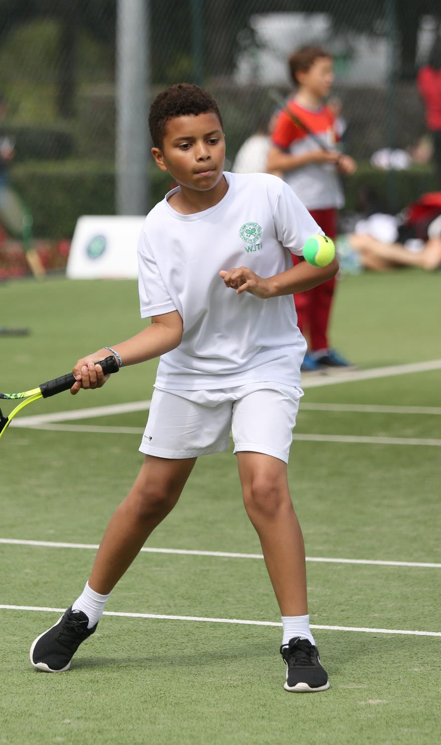
PERSONAL REFLECTION
      Give yourself a score out of 10 for each of these skills
      (10 = very confident in this skill, 0= I don’t have this skill at all).
  Communication
  Self-management
  Team-player
  Perseverance
  Resilience
  Respect
      Pick one skill you would like
      to develop and decide on one action you could take in school, on work experience or at
      home to develop this transferrable skill.
Notes:
Reflection (3 mins)
Ask students to complete this personal reflection exercise think about how they can develop their own transferrable skills in school or extra curricular activities to help prepare them for the world of work.
Additional Reflection if time allows: How does the title ‘Advantage’ relate to the learning in the lesson? (N.B. Advantage in tennis means you have the slight lead over your opponent and are close to winning a game.)

